Slide 1
Fault-tolerant design techniques slides made with the collaboration of: Laprie, Kanoon, Romano

Slide 2
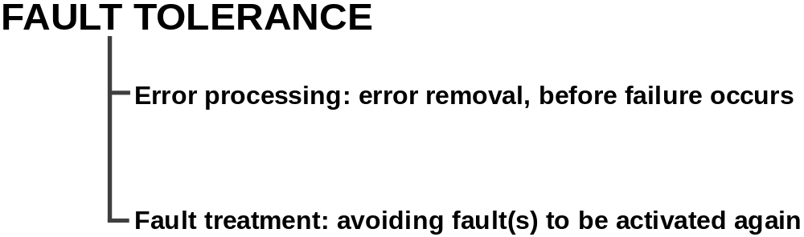
Fault Tolerance – Key Ingredients

Slide 3
Error Processing
ERROR PROCESSING
Error de
tection:
identification of erroneous state(s)
Error diagnosis
: damage assessment
Error recovery:
error-free state substituted to erroneous state
Backward recovery
: system brought back in state visited
before error occurrence
Recovery points (checkpoint)
Forward recovery:
Erroneous state is discarded and correct one is determined
Without losing any computation.

Slide 4
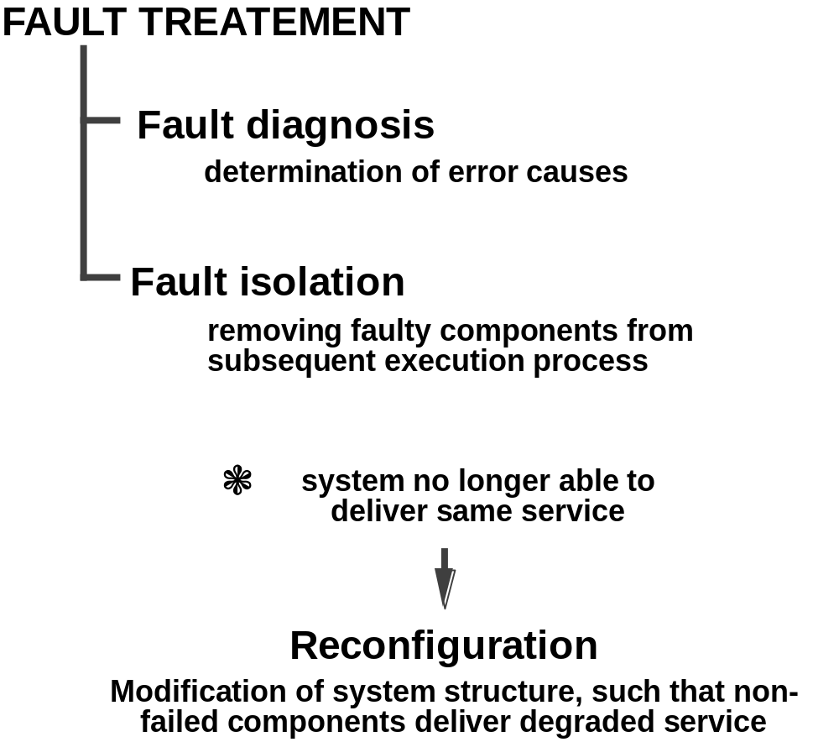
Fault Treatment

Slide 5
Fault Tolerant Strategies
Fault tolerance in computer system is achieved through redundancy in hardware, software, information, and/or time.
Such redundancy can be implemented in static, dynamic, or hybrid configurations.
Fault tolerance can be achieved by many techniques:
  Fault masking is any process that prevents faults in a system from introducing errors. Example: Error correcting memories and majority voting.
  Reconfiguration is the process of eliminating faulty component from a system and restoring the system to some operational state.

Slide 6
Reconfiguration Approach
Fault detection is the process of recognizing that a fault has occurred. Fault detection is often required before any recovery procedure can be initiated.
Fault location is the process of determining where a fault has occurred so that an appropriate recovery can be initiated.
Fault containment is the process of isolating a fault and preventing the effects of that fault from propagating throughout the system.
Fault recovery is the process of regaining operational status via reconfiguration even in the presence of faults.

Slide 7
The Concept of Redundancy
Redundancy is simply the addition of information, resources, or time beyond what is needed for normal system operation.
Hardware redundancy is the addition of extra hardware, usually for the purpose either detecting or tolerating faults.
Software redundancy is the addition of extra software, beyond what is needed to perform a given function, to detect and possibly tolerate faults.
Information redundancy is the addition of extra information beyond that required to implement a given function; for example, error detection codes.

Slide 8
The Concept of Redundancy (Cont’d)
Time redundancy uses additional time to perform the functions of a system such that fault detection and often fault tolerance can be achieved. Transient faults are tolerated by this.
The use of redundancy can provide additional capabilities within a system. But, redundancy can have very important impact on a system's performance, size, weight and power consumption.

Slide 9
HARDWARE REDUNDANCY

Slide 10
Hardware Redundancy
Static techniques use the concept of fault masking. These techniques are designed to achieve fault tolerance without requiring any action on the part of the system. Relies on voting mechanisms.
(also called passive redundancy or fault-masking)
Dynamic techniques achieve fault tolerance by detecting the existence of faults and performing some action to remove the faulty hardware from the system. That is, active techniques use fault detection, fault location, and fault recovery in an attempt to achieve fault tolerance.
(also called active redundancy )

Slide 11
Hardware Redundancy (Cont’d)
Hybrid techniques combine the attractive features of both the passive and active approaches.
  Fault masking is used in hybrid systems to prevent erroneous results from being generated.
  Fault detection, location, and recovery are also used to improve fault tolerance by removing faulty hardware and replacing it with spares.

Slide 12
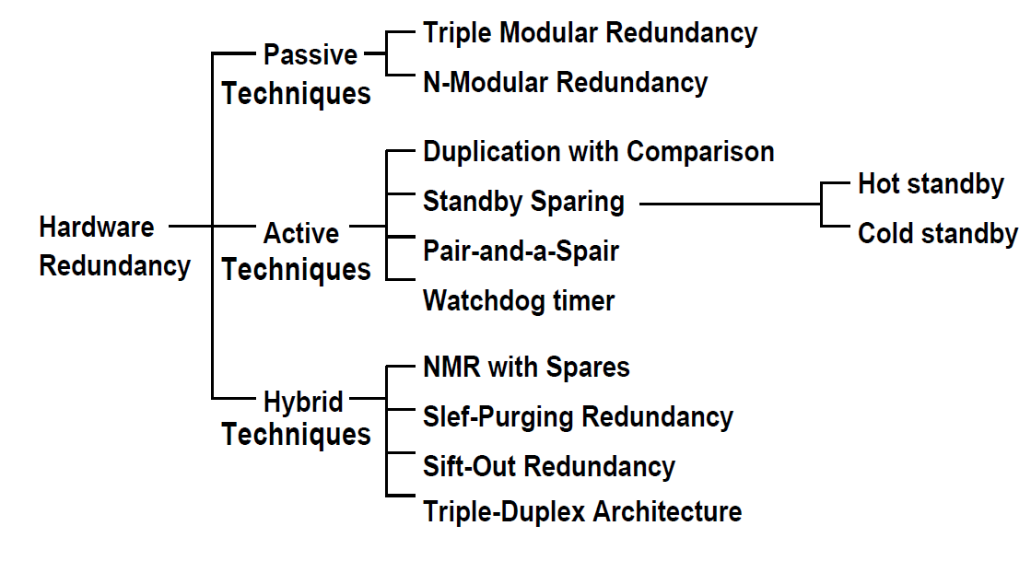
Hardware Redundancy - A Taxonomy

Slide 13
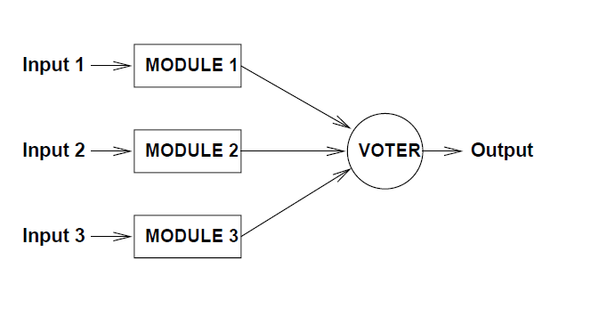
Triple Modular Redundancy (TMR)
Masks failure of a single component.
Voter is a SINGLE POINT OF FAILURE.

Slide 14
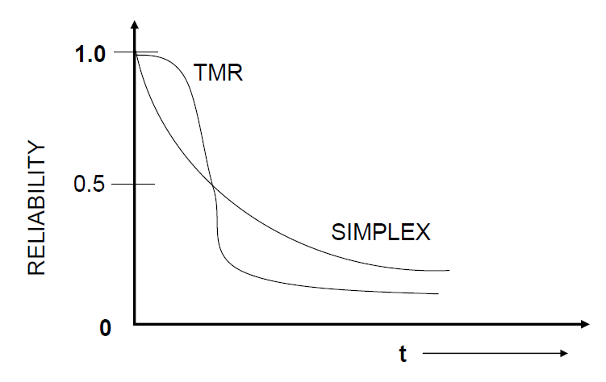
Reliability of TMR
Ideal Voter (R_{V}(t)=1)
R_{SYS}(t)=R_{M}(t)³+3R_{M}(t)²[1-R_{M}(t)]=3R_{M}(t)²-2R_{M}(t)³
Non-ideal Voter
R’_{SYS}(t)=R_{SYS} (t)R_{V}(t)
R_{M}(t)=e^{-λt}
R_{SYS}(t)=3 e^{-2λt} -2e^{-3λt}

Slide 15
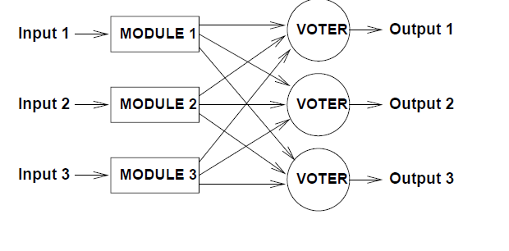
TMR with Triplicate Voters

Slide 16
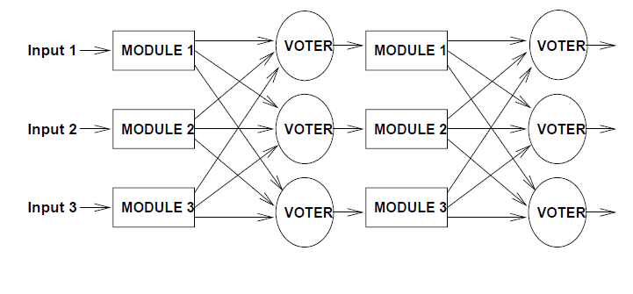
Multistage TMR System

Slide 17
N-Modular Redundancy (NMR)
Generalization of TMR employing N modules rather than 3.
PRO:
  If N>2f, up to f faults can be tolerated:
    e.g. 5MR allows tolerating the failures of two modules
CON:
  Higher cost wrt TMR

Slide 18
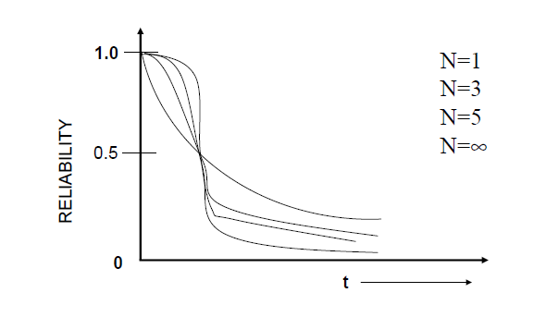
Reliability Plot

Slide 19
Hardware vs Software Voters
The decision to use hardware voting or software voting depends on:
  The availability of processor to perform voting.
  The speed at which voting must be performed.
  The criticality of space, power, and weight limitations.
  The flexibility required of the voter with respect to future changes in the system.
Hardware voting is faster, but at the cost of more hardware.
Software voting is usually slow, but no additional hardware cost.

Slide 20
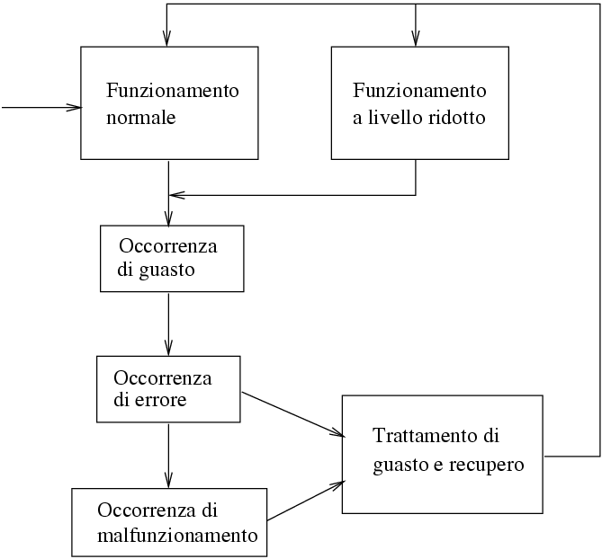
Dynamic (or active) redundancy
Normal
functioning
Degraded
functioning
Fault
Occurrence
Error
Occurrence
Fault Containment and Recovery
Failure
Occurrence

Slide 21
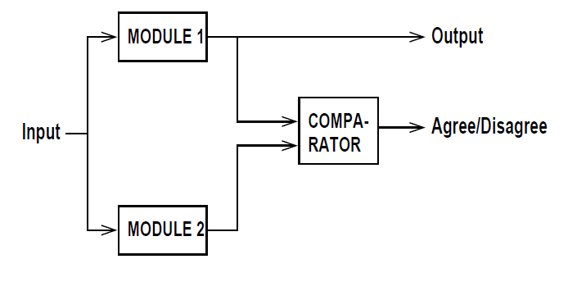
Duplication with Comparison

Slide 22
Standby Sparing
In standby sparing, one module is operational and one or more modules serve as standbys or spares.
If a fault is detected and located, the faulty module is removed from the operation and replaced with a spare.
Hot standby sparing: the standby modules operate in synchrony with the online modules and are prepared to take over any time.
Cold standby sparing: the standby modules s are unpowered until needed to replace a faulty module. This involves momentary disturbance in the service.

Slide 23
Standby Sparing (Cont’d)
Hot standby is used in application such as process control where the reconfiguration time needs to be minimized.
Cold standby is used in applications where power consumption is extremely important.
The key advantage of standby sparing is that a system containing n identical modules can often provide fault tolerance capabilities with significantly fewer power consuption than n redundant modules.

Slide 24
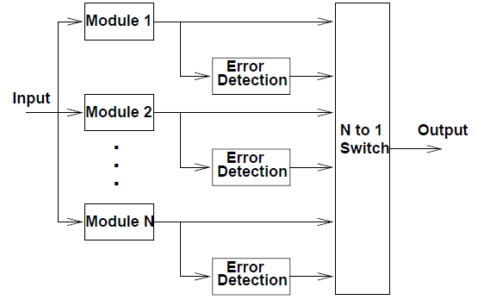
Standby Sparing (Cont’d)
Here, one of the N modules is used to provide system’s output and the remaining (N-1) modules serve as spares.

Slide 25
Pair-and-a-Spare Technique
Pair-and-a-Spare technique combines the features present in both standby sparing and duplication with comparison.
Two modules are operated in parallel at all times and their results are compared to provide the error detection capability required in the standby sparing approach.
second duplicate (pair, and possibly more in case of pair and k-spare) is used to take over in case the working duplicate (pair) detects an error
a pair is always operational

Slide 26
Pair-and-a-Spare Technique (Cont’d)
=
Output
=

Slide 27
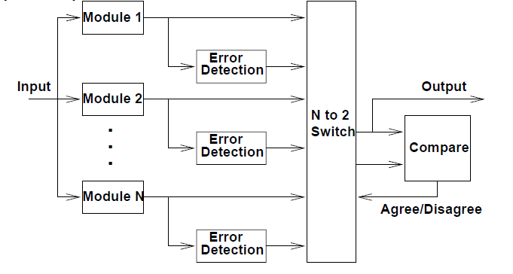
Pair-and-a-Spare Technique (Cont’d)
Two modules are always online and compared, and any spare replace either of the online modules.

Slide 28

Mettere figura di impianto…….

Slide 29
Watchdog Timers
The concept of a watchdog timer is that the lack of an action is an indicative of fault.
A watchdog timer is a timer that must be reset on a repetitive basis.
The fundamental assumption is that the system is fault free if it possesses the capability to repetitively perform a function such as setting a timer.
The frequency at which the timer must be reset is application dependent.
A watchdog timer can be used to detect faults in both the hardware and the software of a system.

Slide 30
Hybrid redundancy
Hybrid hardware redundancy
  Key - combine passive and active redundancy schemes
  NMR with spares
    example - 5 units
      3 in TMR mode
      2 spares
      all 5 connected to a switch that can be reconfigured
    comparison with 5MR
      5MR can tolerate only two faults where as hybrid scheme can tolerate three faults that occur sequentially
      cost of the extra fault-tolerance: switch

Slide 31
Hybrid redundancy
Initially
active
modules
Voter
Switch
Output
Spares

Slide 32
NMR with spares
The idea here is to provide a basic core of N modules arranged in a form of voting configuration and spares are provided to replace failed units in the NMR core.
The benefit of NMR with spares is that a voting configuration can be restored after a fault has occurred.

Slide 33
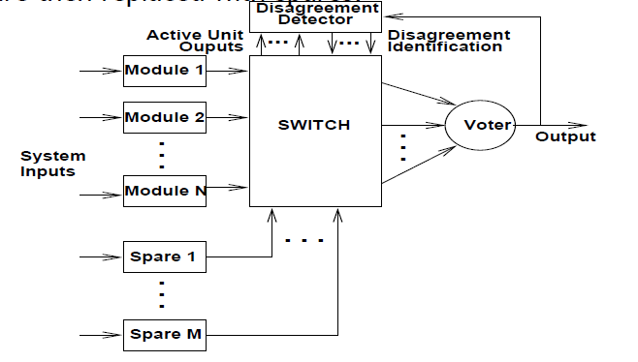
NMR with Spares (Cont’d)
The voted output is used to identify faulty modules, which are then replaced with spares.

Slide 34
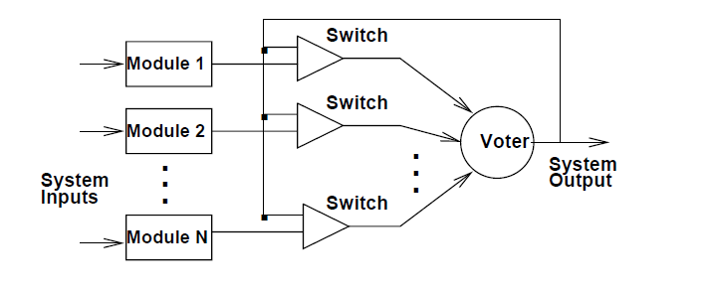
Self-Purging Redundancy
This is similar to NMR with spares except that all the modules are active, whereas some modules are not active (i.e., the spares) in the NMR with spares.

Slide 35
Sift-Out Modular Redundancy
It uses N identical modules that are configured into a system using special circuits called comparators, detectors, and collectors.
The function of the comparator is used to compare each module's output with remaining modules' outputs.
The function of the detector is to determine which disagreements are reported by the comparator and to disable a unit that disagrees with a majority of the remaining modules.

Slide 36
Sift-Out Modular Redundancy (Cont’d)
The detector produces one signal value for each module. This value is 1, if the module disagrees with the majority of the remaining modules, 0 otherwise.
The function of the collector is to produce system's output, given the outputs of the individual modules and the signals from the detector that indicate which modules are faulty.

Slide 37
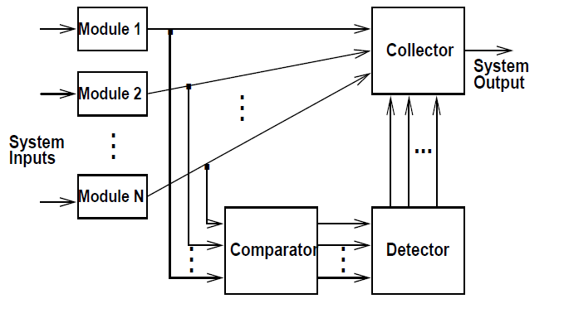
Sift-Out Modular Redundancy (Cont’d)
All modules are compared to detect faulty modules.

Slide 38
Hardware Redundancy - Summary
Static techniques rely strictly on fault masking.
Dynamic techniques do not use fault masking but instead employ detection, location, and recovery techniques (reconfiguration).
Hybrid techniques employ both fault masking and reconfiguration.
In terms of hardware cost, dynamic technique is the least expensive, static technique in the middle, and the hybrid technique is the most expensive.

Slide 39
TIME REDUNDANCY

Slide 40
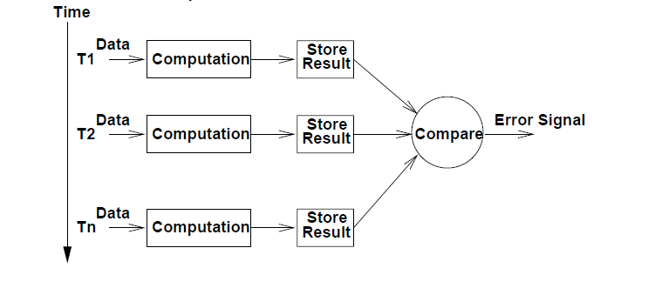
Time Redundancy - Transient Fault Detection
In time redundancy, computations are repeated at different points in time and then compared. No extra hardware is required.

Slide 41
Time Redundancy - Permanent Fault Detection
During first computation, the operands are used as presented.
During second computation, the operands are encoded in some fashion.
The selection of encoding function is made so as to allow faults in the hardware to be detected.
Approaches used, e.g., in ALUs:
  Alternating logic
  Recomputing with shifted operands
  Recomputing with swapped operands
  ...

Slide 42
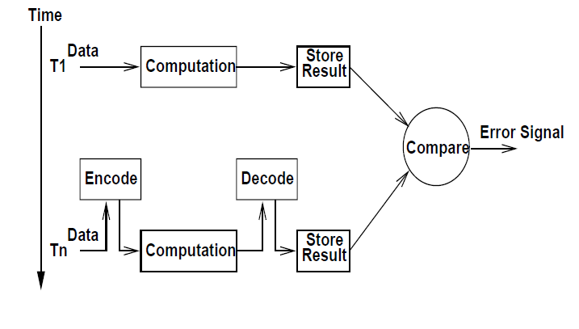
Time Redundancy - Permanent Fault Detection (Cont’d)

Slide 43
SOFTWARE REDUNDANCY

Slide 44
Software Redundancy – to Detect Hardware Faults
Consistency checks use a priori knowledge about the characteristics of the information to verify the correctness of that information.
Example: Range checks, overflow and underflow checks.
Capability checks are performed to verify that a system possesses the capability expected.
Examples: Memory test - a processor can simply write specific patterns to certain memory locations and read those locations to verify that the data was stored and retrieved properly.

Slide 45
Software Redundancy - to Detect Hardware Faults (Cont’d)
ALU tests: Periodically, a processor can execute specific instructions on specific data and compare the results to known results stored in ROM.
Testing of communication among processors, in a multiprocessor, is achieved by periodically sending specific messages from one processor to another or writing into a specific location of a shared memory.

Slide 46
Software Implemented Fault Tolerance Against Hardware Faults. An example.
Output
Comparator
Mismatch
Disagreement triggers interrupts to both processors.
Both run self diagnostic programs
The processor that find itself failure free within a specified time continues operation
The other is tagged for repair

Slide 47
Software Redundancy - to Detect Hardware Faults. One more example.
All modern day microprocessors use instruction retry
Any transient fault that causes an exception such as parity violation is retried
Very cost effective and is now a standard technique

Slide 48
Software Redundancy - to Detect Software Faults
There are two popular approaches: N-Version Programming (NVP) and Recovery Blocks (RB).
NVP is a forward recovery scheme - it masks faults.
RB is a backward error recovery scheme.
In NVP, multiple versions of the same task is executed concurrently, whereas in RB scheme, the versions of a task are executed serially.
NVP relies on voting.
RB relies on acceptance test.

Slide 49
N-Version Programming (NVP)
NVP is based on the principle of design diversity, that is coding a software module by different teams of programmers, to have multiple versions.
The diversity can also be introduced by employing different algorithms for obtaining the same solution or by choosing different programming languages.
NVP can tolerate both hardware and software faults.
Correlated faults are not tolerated by the NVP.
In NVP, deciding the number of versions required to ensure acceptable levels of software reliability is an important design consideration.

Slide 50
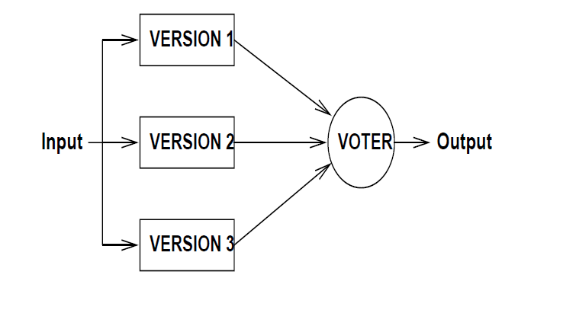
N-Version Programming (Cont’d)

Slide 51
Recovery Blocks (RB)
RB uses multiple alternates (backups) to perform the same function; one module (task) is primary and the others are secondary.
The primary task executes first. When the primary task completes execution, its outcome is checked by an acceptance test.
If the output is not acceptable, a secondary task executes after undoing the effects of primary (i.e., rolling back to the state at which primary was invoked) until either an acceptable output is obtained or the alternates are exhausted.

Slide 52
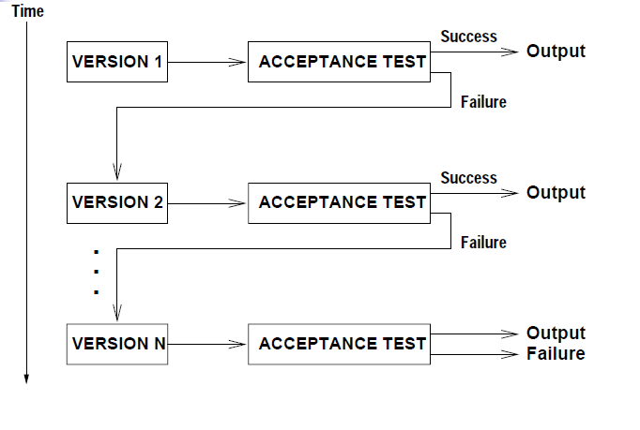
Recovery Blocks (Cont’d)

Slide 53
Recovery Blocks (Cont’d)
The acceptance tests are usually sanity checks; these consist of making sure that the output is within a certain acceptable range or that the output does not change at more than the allowed maximum rate.
Selecting the range for the acceptance test is crucial. If the allowed ranges are too small, the acceptance tests may label correct outputs as bad (false positives). If they are too large, the probability that incorrect outputs will be accepted (false negatives) will be more .
RB can tolerate software faults because the alternates are usually implemented with different approaches; RB is also known as Primary-Backup approach.

Slide 54
Single Version Fault Tolerance:
Software Rejuvenation
Example: Rebooting a PC
As a process executes
  it acquires memory and file-locks without properly releasing them
  memory space tends to become increasingly fragmented
The process can become faulty and stop executing
To head this off, proactively halt the process, clean up its internal state, and then restart it
Rejuvenation can be time-based or prediction-based
Time-Based Rejuvenation - periodically
Rejuvenation period - balance benefits against cost

Slide 55
INFORMATION REDUNDANCY

Slide 56
Information Redundancy
Guarantee data consistency by exploiting additional information to achieve a redundant encoding.
Redundant codes permit to detect or correct corrupted bits because of one or more faults:
  Error Detection Codes (EDC)
  Error Correction Codes (ECC)

Slide 57
Functional Classes of Codes
Single error correcting codes
  any one bit can be detected and corrected
Burst error correcting codes
  any set of consecutive b bits can be corrected
Independent error correcting codes
  up to t errors can be detected and corrected
Multiple character correcting codes
  n-characters, t of them are wrong, can be recovered
Coding complexity goes up with number of errors
  Sometimes partial correction is sufficient

Slide 58
Block Codes
Code words are represented by n-tuples or n-vectors
  Information is only k bits
  Redundancy normalization (n-k)/n or r/n
  It is called (n, k) code
Binary Code
  by far most important
  lends itself to mathematical treatment
Encoding: converting source codes into block codes
Decoding: Inverse operation of encoding
Error detection (EDC) and Error correction (ECC) codes

Slide 59
Redundant Codes
Let:
b: be the code’s alphabet size (the base in case of numerical codes);
n: the (constant) block size;
N: the number of elements in the source code;
m: the minimum value of n which allows to encode all the elements in the source code, i.e. minimum m such that b^{m} >= N
A block code is said
Not redudant if n = m
Redundant if n > m
Ambiguous if n < m

Slide 60
Binary Codes: Hamming distance
The Hamming distance d(x,y) between two words (x,y) of a code (C)
is the number of different positions (bits) between x and y
d( 10010 , 01001 ) = 4
d( 11010 , 11001 ) = 2
The minimum distance of a code is
d_{min} = min(d(x,y)) for all x ≠ y in C

Slide 61
Ambiguity and redundancy
Not redundant codes h = 1 (and n = m)
Redundant codes h >= 1 (and n > m)
Ambiguous codes h = 0

Slide 62
Hamming Distance: Examples
Words of C
First
Code
Second
Code
Third
Code
Fourth
code
Fifth
code
alfa
000
0000
00
0000
110000
beta
001
0001
01
0011
100011
gamma
010
0010
11
0101
001101
delta
011
0011
10
0110
010110
mu
100
0100
00
1001
011011
h = 1 h = 1 h = 0 h >= 2 h = 3
Not Red. Amb. Red. Red.
Red.
(EDC) (ECC)

Slide 63
Gray Code(reflex binary code)
Binary codes where encodings of subsequent values differ by a single bit
001
010
001
011
1
2
1
2
0 | 0 | 0
0 | 0 | 0
3
011
3
010
000
0
000
0
111
7
4
100
100
7
4
110
110
6
5
101
101
6
5
111
Dec. Binario GRAY-2 GRAY-3
0 000 0 0 0 00
1 001 0 1 0 01
2 010 1 1 0 11
3 011 1 0 0 10
4 100 1 10
5 101 1 11
6 110 1 01
7 111 1 00
A n+1 bits Gray code can be obtained recursively from a n bits code
as follows:
  The first 2^{n} words of the n+1 bits code are identical to those of
  the n bits code extended (MSB) with ‘0’
  The remaining 2^{n} words words of the n+1 bits code are
  identical to those of the n bits code arranged in reverse order
  and extended (MSB) with ‘1’

Slide 64
Error Detecting Codes (EDC)
error
TX
10001
10001
11001
RX
Link
Transmitter
Receiver
To“detect” transmission erroes the transmittin system
introduces redundancy in the transmitted information.
In an error detecting code the occurrence of an error
on a word of the code generates a word not belonging to the code
The error weight is the number (and distribution) of corrupted bits tolerated by the code.
In binary systems there are only two error possibilities
Trasmit 0 Receive 1
Trasmit 1 Receive 0

Slide 65
Error Detection Codes
The Hamming distance d(x,y) between two words (x,y) of a code (C)
is the number of different positions (bits) between x and y
d( 10010 , 01001 ) = 4
d( 11010 , 11001 ) = 2
The minimum distance of a code is
d_{min} = min(d(x,y)) for all x ≠ y in C
A code having minimum distance d is
able to detect errors with weight ≤ d-1

Slide 66
Error Detecting Codes
Code 1 Code 2
A => 000 000
B => 100 011
C => 011 101
D => 111 110
110
111
110
111
100
101
100
101
010
011
010
011
000
001
000
001
d_{min}=1
d_{min}=2
Legal code words
Illegal code words

Slide 67
Parity Code (minimum distance 2)
A code having d_{min} =2 can be obtained by using the following expressions:
d₁ + d₂ + d₃ + ….. + d_{n} + p = 0 parity (even number of “1”) or
d₁ + d₂ + d₃ + ….. + d_{n} + p = 1 odd number of “1”
Being n the number of bits of the original block code and + is modulo 2 sum operator
and p is the parity bit to add to the original word to obtain an EDC code
Information Parity Parity
(even) (odd)
000 000 0 000 1
001 001 1 001 0
010 010 1 010 0
011 011 0 011 1
100 100 1 100 0
101 101 0 101 1
110 110 0 110 1
111 111 1 111 0
A code with minimum distance equal to 2
can detect errors having weight 1 (single error)

Slide 68
Parity Code
Information bits to send
Received information bits
Transm.
System
Gen.
parity
Parity bit
Received parity
Verify
parity
Signal Error
I₁ + I₂ + I₃ + p = 0
I₁ + I₂ + I₃ + p = ?
If equal to 0 there has been no single error
If equal to 1 there has been a single error
Ex. I trasmit 101
Parity generator computes the parity bit 1 + 0 + 1 + p = 0, namely p = 0 and 1010 is transmitted
If 1110 is received, the parity check detects an error 1 + 1 + 1 + 0 = 1 ≠0
If 1111 is received: 1+1+1+1 = 0 all right??, no single mistakes!!
(double/even weight errors are unnoticeable)

Slide 69
Error Correcting Codes
A code having minimum distance d can correct errors
with weight ≤ (d-1)/2
When a code has minimum distance 3 can correct errors having weight = 1
001010
001110
2
001101
1
001001
001011
3
001100
d = 3
001000
001111
000000
101111
101000
000111
011000
001111

Slide 70
Redundant Array of Inexpensive Disks
RAID

Slide 71
RAID Architecture
RAID: Redundant Array of Inexpensive Disks
  Combine multiple small, inexpensive disk drives into a group to yield performance exceeding that of one large, more expensive drive
  Appear to the computer as a single virtual drive
  Support fault-tolerance by redundantly storing information in various ways
  Uses Data Striping to achieve better performance

Slide 72
Basic Issues
Two operations performed on a disk
  Read() : small or large.
  Write(): small or large.
Access Concurrency is the number of simultaneous requests the can be serviced by the disk system
Throughput is the number of bytes that can be read or written per unit time as seen by one request
Data Striping: spreading out blocks of each file across multiple disk drives.
The stripe size is the same as the block size

Slide 73
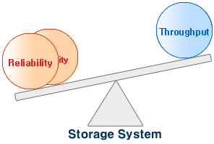
Basic Issues
The Stripe will introduces a tradeoff between I/O throughput and Access concurrency
  Small Stripe means high throughput but no or few access concurrency.
  Large strip size provides better access concurrency but less throughput for single request

Slide 74

RAID Levels: RAID-0
No Redundancy
  No Fault Tolerance, If one drive fails then all data in the array is lost.
High I/O performance
  Parallel I/O
Best Storage efficiency

Slide 75
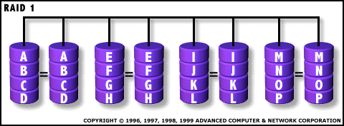
RAID-1
Disk Mirroring
  Poor Storage efficiency.
Best Read Performance: Maybe double.
Poor write Performance: two disks to be written.
Good fault tolerance: as long as one disk of a pair is working then we can perform R/W operations.

Slide 76
RAID-2
Bit Level Striping.
Uses Hamming Codes, a form of Error Correction Code (ECC).
Can Tolerate Disk one Failure.
# Redundant Disks = O (log (total disks)).
Better Storage efficiency than mirroring.
High throughput but no access concurrency:
  disks need to be ALWAYS simulatenously accessed
    Synchronized rotation
Expensive write.
Example, for 4 disks 3 redundant disks to tolerate one disk failure

Slide 77
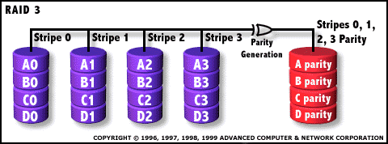
RAID-3
Byte Level Striping with parity.
No need for ECC since the controller knows which disk is in error. So parity is enough to tolerate one disk failure.
Best Throughput, but no concurrency.
Only one Redundant disk is needed.

Slide 78
RAID-3 (example in which there is only a strip (byte) for disk)
Logic Record
10010011
11001101
10010011
. . .
P
1
0
0
1
0
0
1
1
0
1
1
0
0
1
1
0
1
1
1
0
0
1
0
0
1
1
0
1
1
0
0
1
1
0
1
1
Physical Record

Slide 79
RAID-4
Block Level Striping.
Stripe size introduces the tradeoff between access concurrency versus throughput.
Block Interleaved parity.
Parity disk is a bottleneck in the case of a small write where we have multiple writes at the same time.
No problems for small or large reads.

Slide 80
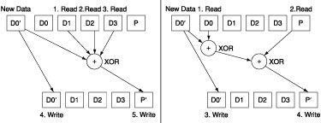
Writes in RAID-3 and RAID-4.
In general writes are very expensive.
  Option 1: read data on all other disks, compute new parity P’ and write it back
    Ex.: 1 logical write= 3 physical reads + 2 physical writes
  Option 2: che new data D0 with the new one D0’, add the difference to P, and write back P’
    Ex.: 1 logical write= 2 physical reads + 2 physical writes

Slide 81
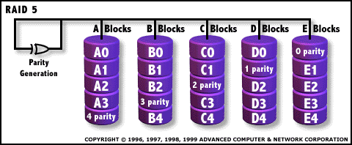
RAID-5
Block-Level Striping with Distributed parity.
Parity is uniformly distributed across disks.
Reduces the parity Bottleneck.
Best small and large read (same as 4).
Best Large write.
Still costly for small write

Slide 82

Writes in Raid 5
D0
D1
D2
D3
P
D4
D5
D6
P
D7
Concurrent writes are possible thanks to the interleaved parity
Ex.: Writes of D0 and D5 use disks 0, 1, 3, 4
D8
D9
P
D10
D11
D12
P
D13
D14
D15
P
D16
D17
D18
D19
D20
D21
D22
D23
P
disk 0 disk 1 disk 2 disk 3 disk 4

Slide 83
Summary of RAID Levels

Slide 84
Limits of RAID-5
RAID-5 is probably the most employed scheme
The larger the number of drives in a RAID-5, the better performances we may get...
...but the larger gets the probability of double disk failure:
  After a disk crash, the RAID system needs to reconstruct the failed crash:
    detect, replace and recreate a failed disk
    this can take hours if the system is busy
  The probability that one disk out N-1 to crashes within this vulnerability window can be high if N is large:
    especially considering that drives in an array have typically the same age => correlated faults
    rebuilding a disk may cause reading a HUGE number of data
    may become even higher than the probability of a single disk’s failure

Slide 85
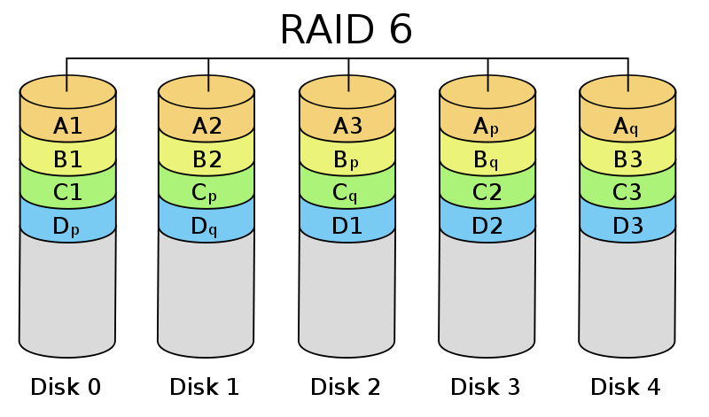
RAID-6
Block-level striping with dual distributed parity.
Two sets of parity are calculated.
Better fault tolerance
  Can handle two faulty disks.
Writes are slightly worse than 5 due to the added overhead of more parity calculations.
May get better read performance than 5 because data and parity is spread into more disks.
If one disks fail, then levels 6 becomes level 5.

Slide 86
Error Propagation in
Distributed Systems and
Rollback Error
Recovery Techniques

Slide 87
System Model
System consists of a fixed number (N) of processes which communicate only through messages.
Processes cooperate to execute a distributed application program and interact with outside world by receiving and sending input and output messages, respectively.
Output
Messages
Input Messages
Outside World
Message-passing system
P₀
m₁
P₁
m₂
P₂

Slide 88
Rollback Recovery in a Distributed System
Rollback recovery treats a distributed system as a collection of processes that communicate through a network
Fault tolerance is achieved by periodically using stable storage to save the processes’ states during the failure-free execution.
Upon a failure, a failed process restarts from one of its saved states, thereby reducing the amount of lost computation.
Each of the saved states is called a checkpoint

Slide 89
Checkpoint based Recovery: Overview
Uncoordinated checkpointing: Each process takes its checkpoints independently
Coordinated checkpointing: Process coordinate their checkpoints in order to save a system-wide consistent state. This consistent set of checkpoints can be used to bound the rollback
Communication-induced checkpointing: It forces each process to take checkpoints based on information piggybacked on the application messages it receives from other processes.

Slide 90
Consistent System State
A consistent system state is one in which if a process’s state reflects a message receipt, then the state of the corresponding sender reflects sending that message.
A fundamental goal of any rollback-recovery protocol is to bring the system into a consistent state when inconsistencies occur because of a failure.

Slide 91
Example
Consistent state
P₀
m₁
P₁
m₂
P₂
Inconsistent state
P₀
m₁
P₁
m₂
P₂
“m₂” becomes the orphan message

Slide 92
Checkpointing protocols
Each process periodically saves its state on stable storage.
The saved state contains sufficient information to restart process execution.
A consistent global checkpoint is a set of N local checkpoints, one from each process, forming a consistent system state.
Any consistent global checkpoint can be used to restart process execution upon a failure.
The most recent consistent global checkpoint is termed as the recovery line.
In the uncoordinated checkpointing paradigm, the search for a consistent state might lead to domino effect.

Slide 93
Domino effect: example
Recovery Line
P₀
m₂
m₇
m₀
m₃
m₅
P₁
m₄
m₆
m₁
P₂
Domino Effect: Cascaded rollback which causes the system to roll back to too far in the computation (even to the beginning), in spite of all the checkpoints

Slide 94
Interactions with outside world
A message passing system often interacts with the outside world to receive input data or show the outcome of a computation. If a failure occurs the outside world cannot be relied on to rollback.
For example, a printer cannot rollback the effects of printing a character, and an automatic teller machine cannot recover the money that it dispensed to a customer.
It is therefore necessary that the outside world perceive a consistent behavior of the system despite failures.

Slide 95
Interactions with outside world (contd.)
Thus, before sending output to the outside world, the system must ensure that the state from which the output is sent will be recovered despite of any future failure
Similarly, input messages from the outside world may not be regenerated, thus the recovery protocols must arrange to save these input messages so that they can be retrieved when needed.

Slide 96
Garbage Collection
Checkpoints and event logs consume storage resources.
As the application progresses and more recovery information collected, a subset of the stored information may become useless for recovery.
Garbage collection is the deletion of such useless recovery information.
A common approach to garbage collection is to identify the recovery line and discard all information relating to events that occurred before that line.

Slide 97
Checkpoint-Based Protocols
Uncoordinated Check pointing
  Allows each process maximum autonomy in deciding when to take checkpoints
  Advantage: each process may take a checkpoint when it is most convenient
  Disadvantages:
    Domino effect
    Possible useless checkpoints
    Need to maintain multiple checkpoints
    Garbage collection is needed
    Not suitable for applications with outside world interaction (output commit)

Slide 98
Coordinated Checkpointing
Coordinated checkpointing requires processes to orchestrate their checkpoints in order to form a consistent global state.
It simplifies recovery and is not susceptible to the domino effect, since every process always restarts from its most recent checkpoint.
Only one checkpoint needs to be maintained and hence less storage overhead.
No need for garbage collection.
Disadvantage is that a large latency is involved in committing output, since a global checkpoint is needed before output can be committed to the outside world.

Slide 99
Blocking Coordinated Checkpointing
Phase 1: A coordinator takes a checkpoint and broadcasts a request message to all processes, asking them to take a checkpoint.
When a process receives this message, it stops its execution and flushes all the communication channels, takes a tentative checkpoint, and sends an acknowledgement back to the coordinator.
Phase 2: After the coordinator receives all the acknowledgements from all processes, it broadcasts a commit message that completes the two-phase checkpointing protocol.
After receiving the commit message, all the processes remove their old permanent checkpoint and make the tentative checkpoint permanent.
Disadvantage: Large Overhead due to large block time

Slide 100
Communication-induced checkpointing
Avoids the domino effect while allowing processes to take some of their checkpoints independently.
However, process independence is constrained to guarantee the eventual progress of the recovery line, and therefore processes may be forced to take additional checkpoints.
The checkpoints that a process takes independently are local checkpoints while those that a process is forced to take are called forced checkpoints.

Slide 101
Communication-induced checkpoint (contd.)
Protocol related information is piggybacked to the application messages:
  receiver uses the piggybacked information to determine if it has to force a checkpoint to advance the global recovery line.
The forced checkpoint must be taken before the application may process the contents of the message, possibly incurring high latency and overhead:
  Simplest communication-induced checkpointing:
    force a checkpoint whenever a message is received, before processing it
  reducing the number of forced checkpoints is important.
No special coordination messages are exchanged.

